Slide 1
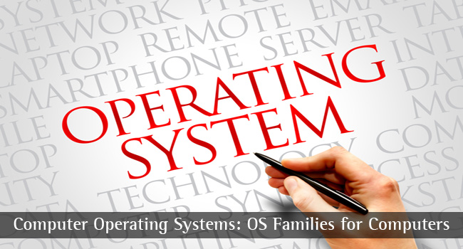
CS-3103 : Operating Systems : Sec-A (NB) : Process
HIT-BTech-CSEN3103-Operating Systems

Slide 2

Let’s learn about process….
Process Concept – what is a process, Relationships between Processes and Programs
Process Scheduling
Operation on Processes
Cooperating Processes
Concurrency and Parallelism
Inter process Communication
HIT-BTech-CSEN3103-Operating Systems

Slide 3
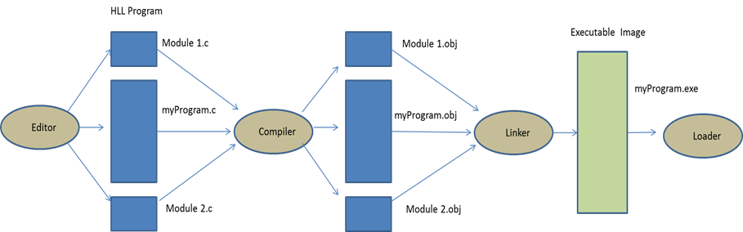
A program written in a high-level language (say C) passes through the following stages before it is loaded in the computer system for execution.
Stages of program development and execution
HIT-BTech-CSEN3103-Operating Systems

Slide 4
Program compilation, linking, loading, CPU allocation and a Process is running….
Create and edit the program’s source code (we call myProgram.c) in an editor, notepad/gedit/vi/codeblock….
Compile the program and its associated modules into intermediate files (myProgram.obj)
Link the program with its associated modules and library functions to obtain executable code (myProgram.exe)
Load ‘myProgram.exe’ into the main memory.
Allocate the CPU to run ‘myProgram.exe’ .
Process: Execution of ‘myProgram.exe’ using resources allocated to it.
HIT-BTech-CSEN3103-Operating Systems

Slide 5
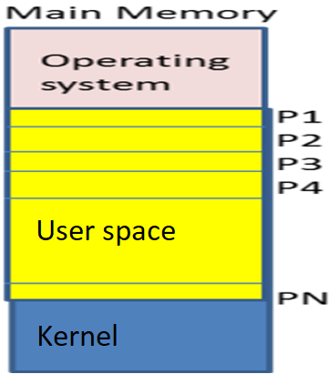
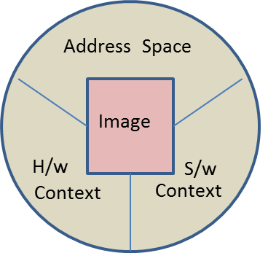
Process Concept
In a multiprogramming environment there are multiple programs that reside in the main memory (MM). Since, each program belongs to a different user, it becomes the responsibility of the operating system to protect one program from another. This is the reason, the OS opens a separate new environment called process for an incoming executable program.
The process consists of the following information about the program:
  Hardware context
  Software context
  Program’s address space
HIT-BTech-CSEN3103-Operating Systems

Slide 6
Process Concept
  Hardware context : This is the information about the hardware status of the process. It consists of details on the current contents of the program counter (PC), general purpose registers (GPR), stack pointer (SP), flag registers etc.
  Software context : In S/w context, we have details such as process id (pid ➔ getpid(), getppid()), process priority (priority scheduling), current state of the process (new, ready, running, wait, sleep, defunct, terminated), quota of memory pages, privileges, owner information (user id, uid can be obtained in unix, bash shell…) etc.
  Program’s address space : This information is about the active pages of the program image, pages returned by the program, page tables etc.
HIT-BTech-CSEN3103-Operating Systems

Slide 7
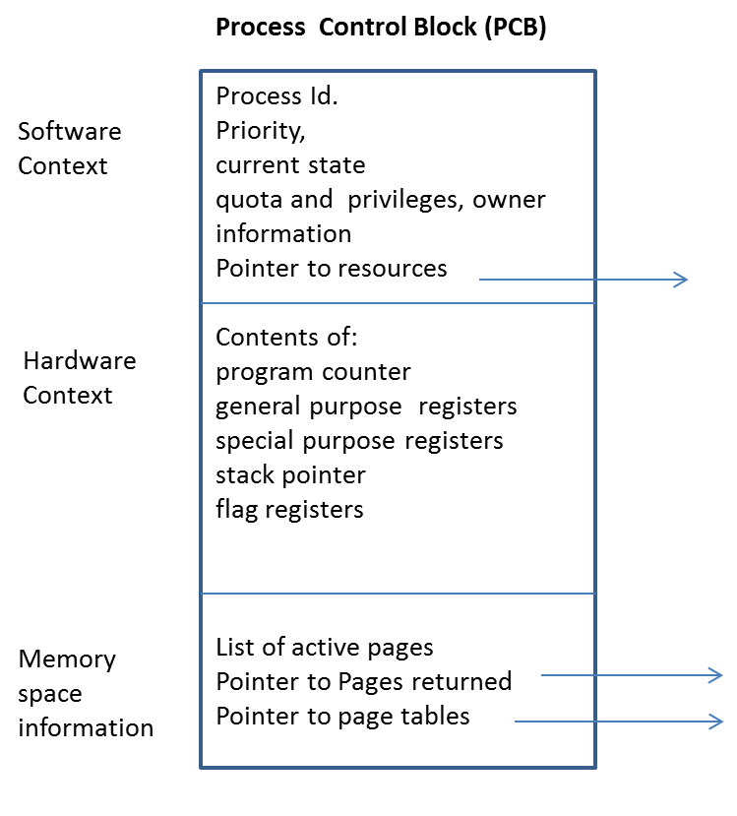
Process Control Block
All the information about the process is stored by the operating system in a data structure called Process Control Block (PCB). A separate PCB is maintained by the OS for every process opened by OS. The process behaves like a unit and the process that executes, not the program….
HIT-BTech-CSEN3103-Operating Systems

Slide 8
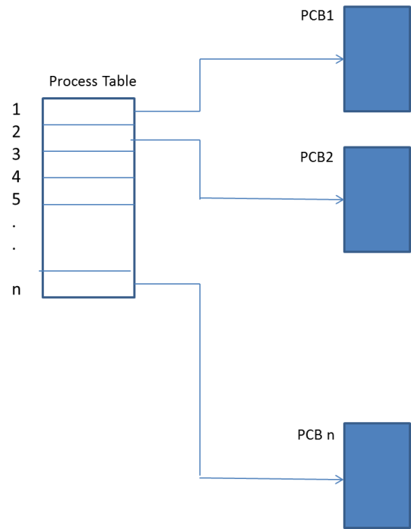
Process Table
As soon as a program is loaded into MM, OS not only opens a process for this program, but also makes an entry about the process into a process table.
This process table is a global data structure that contains pointers to all the resident processes present in the system.
Each process entered in this table has a pointer to its PCB.
HIT-BTech-CSEN3103-Operating Systems

Slide 9
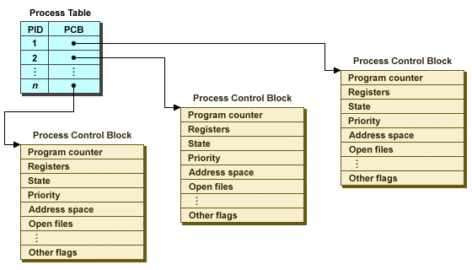
HIT-BTech-CSEN3103-Operating Systems

Slide 10
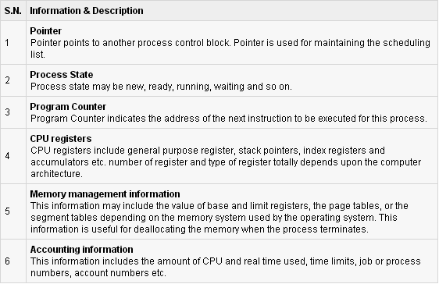
HIT-BTech-CSEN3103-Operating Systems

Slide 11
Process States and State Transitions
The loader, scheduler, dispatcher etc. are important components of an OS.
The loader loads the executable programs into the MM.
For every executable program resident in the memory, the OS opens a process.
These ready to run processes are kept in a queue.
Out of the resident processes, one process is selected by the scheduler for execution (run).
The selection is based on a scheduling policy.
The dispatcher allocates the CPU to the selected process.
If the executing process requests some input/output (I/O) operation, then the process is made to wait till its requested (I/O) operation is completed by the I/O controller.
In the meantime, the CPU is allocated to next scheduled process.
HIT-BTech-CSEN3103-Operating Systems

Slide 12
Process States and State Transitions
As a process executes, it changes state
  new: The process is being created.
  running: Instructions are being executed.
  waiting: The process is waiting for some event to occur.
  ready: The process is waiting to be assigned to a process.
  terminated: The process has finished execution.
HIT-BTech-CSEN3103-Operating Systems

Slide 13

HIT-BTech-CSEN3103-Operating Systems

Slide 14
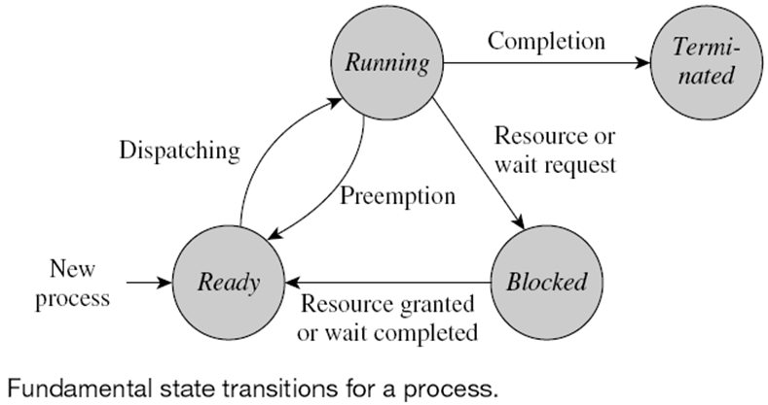
A state transition for a process is a change in its state
  Caused by the occurrence of some event such as the start or end of an I/O operation
HIT-BTech-CSEN3103-Operating Systems

Slide 15
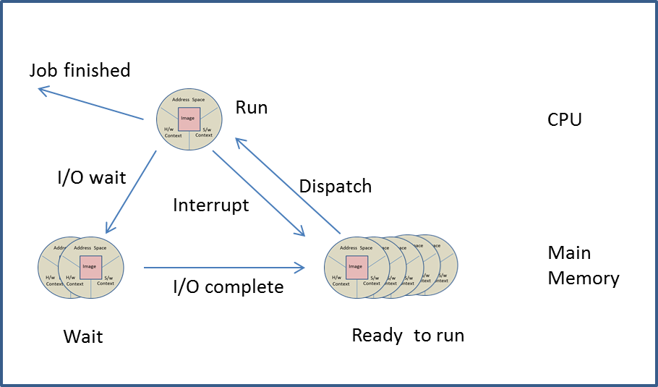
Process States and State Transitions
A process can be in any one of the following states:
  Ready to run -- Run -- Wait
HIT-BTech-CSEN3103-Operating Systems

Slide 16
A couple of important points to note:
Only one process is in the ‘run’ state because the CPU can be allocated to only one process at a time.
If the above ‘running’ process requests an I/O operation, then it joins a ‘wait’ queue. A waiting process is also called ‘blocked’ process.
The waiting process remains in the ‘wait’ queue until its required I/O operation is performed by the I/O controller.
Example: A process may wait for one of the following reasons:
a) Wait for the user to enter data from the keyboard. Any program that need a range to calculate fabonacci series.
b) Wait for a server response. Consider the case when a user clicks a link in a browser (like Google Chrome, Mozilla Firefox), an HTTP request is sent to the concerned server. While this HTTP request is being served, the process (Chrome) has to wait.
HIT-BTech-CSEN3103-Operating Systems

Slide 17
A couple of important points to note:
5. As soon as the I/O operation is complete, the process joins the ‘Ready to run’ queue.
6. From ‘Ready to run’ state, a process (P_{i}) can be dispatched back to ‘run’ state only when it is scheduled so by the CPU scheduler.
7. We have a different case of P_{i} ‘s state transition from ‘run’ to ‘ready to run’ when its allotted time-quanta is over (round-robin scheduling).
HIT-BTech-CSEN3103-Operating Systems

Slide 18
A couple of important points to note:
8. P_{i} leaves CPU for any of the following reasons:
The job is over
A runtime error, like an arithmetic error or a stack overflow, has occurred.
Abnormal termination because of the occurrence of an exception.
Insufficient memory is available in the system.
An invalid instruction execution has occurred.
Error in the input/output operation.
HIT-BTech-CSEN3103-Operating Systems

Slide 19
Degree of multiprogramming
Degree of multiprogramming is defined as the number of active ‘ready to run’ processes present in the main memory (MM) of the computer system.
Initially, the degree of multiprogramming is high because almost all the processes present in the main memory are ‘ready to run’.
However, after some time the degree of multiprogramming decreases, because some of the processes join the ‘wait’ queue where they wait for the completion of some I/O.
When the number of processes in the ‘wait’ queue increases significantly, then, in order to increase the degree of multiprogramming, some of the waiting processes are moved to the secondary storage. This is called ‘Process swap out’.
The swapped out processes are said to be ‘blocked suspended’ (Fig. A)
In addition, to accommodate a higher priority incoming process, a ‘ready to run’ process may also be swapped out and the ‘swapped out’ process is called a ‘ready suspend’.
HIT-BTech-CSEN3103-Operating Systems

Slide 20
Process States and State Transitions
A process can be in any one of the following states:
  Ready to run -- Run -- Wait
Jobs are running in CPU
  Process attaining ‘Ready to run’ and ‘Wait’ states are in MM
HIT-BTech-CSEN3103-Operating Systems

Slide 21
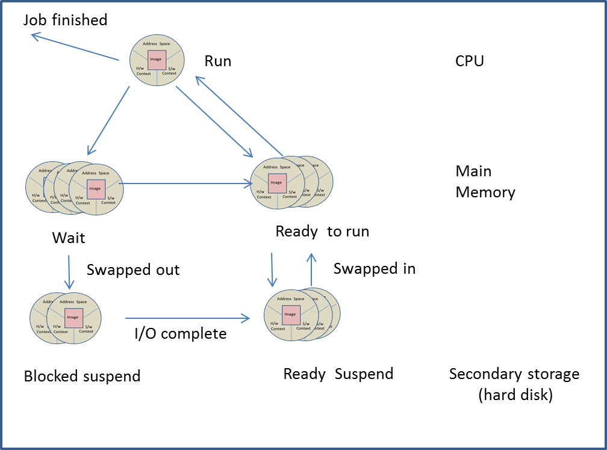
State Diagram of Process States
Jobs running
Resources
Process States
Fig. A
HIT-BTech-CSEN3103-Operating Systems

Slide 22
Degree of multiprogramming
Ready→run: Out of the ‘ready to run’ processes, one process is scheduled to occupy the CPU and move into the ‘run’ state.
Run→Ready: When the time allotted to a running process is completed, P1 leaves the CPU and joins the ‘ready to run’ queue.
Run → Wait: When a running process asks for an I/O operation, it is made to leave the CPU and the process joins the ‘wait’ queue.
Wait → Ready: As soon as the I/O of a waiting process is completed, it joins the ‘ready to run’ state.
Wait → Blocked suspend: When a waiting or blocked process remains in the main memory for long time, it is sometimes swapped out to a swap area on the secondary storage.
Ready → Ready suspend: A ‘ready to run’ process is swapped out to secondary storage to make room for higher priority process.
Blocked suspend → Ready suspend: As and when the I/O operation of a blocked suspend process is completed, P1 joins the ‘ready suspend’ queue in the secondary storage.
Ready suspend → Ready: As soon as some other job terminates, a ‘ready suspend’ process is swapped into the ‘ready’ queue.
HIT-BTech-CSEN3103-Operating Systems

Slide 23

HIT-BTech-CSEN3103-Operating Systems

Slide 24
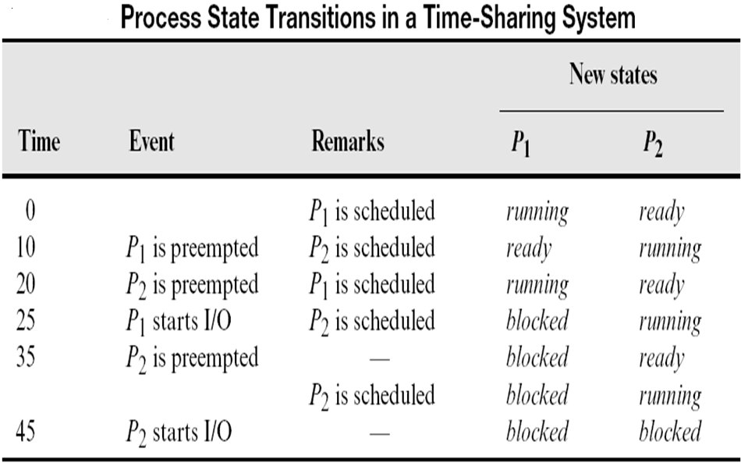
Process State Transitions
A system contains two processes P₁ and P₂
HIT-BTech-CSEN3103-Operating Systems

Slide 25
Concurrent Execution of Programs
How does concurrency provide any benefit?
Answer: Throughput increases by simultaneous operation of processes on a CPU.
Two events or tasks are concurrent or parallel if they occur or are performed at the same time. Ex: fork() system call initiated from a parent process creating a child taking separate address space in MM and running concurrently with the parent. On child's termination, control comes back to parent….
In uniprocessor systems, at the most, one process may be running on the CPU while other processes (if any) are in the ready or waiting states.
In multiprocessor systems, many processes can simultaneously run on different CPUs.
Throughput: number of processes completed per unit time. Turnaround Time: mean time from submission to completion of process. Waiting Time: Amount of time spent ready to run but not running. Response Time: Time between submission of requests and first response to the request
HIT-BTech-CSEN3103-Operating Systems

Slide 26
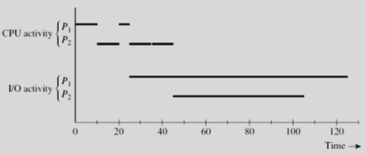
Concurrent Execution of Programs…
The objective of time-sharing is to switch the CPU among processes so frequently that users can interact with each program while it is running.
HIT-BTech-CSEN3103-Operating Systems

Slide 27
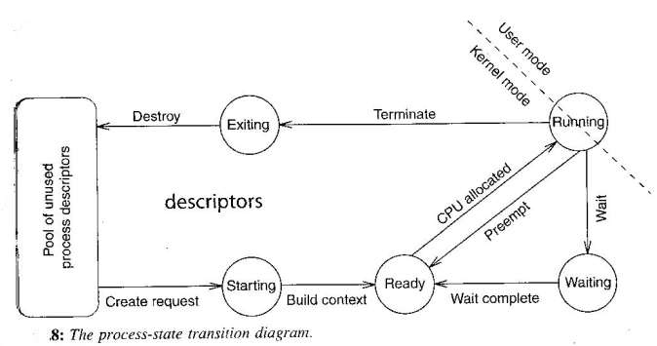
State transition in uniprocessor system
HIT-BTech-CSEN3103-Operating Systems

Slide 28
Concurrent Execution in Multi-process Systems
A multi-process system (or multitasking system) is one that executes many processes concurrently.
The objective of multiprocessing is to have a process running on the processor at all times, doing purposeful work.
Many processes are executed concurrently to improve the performance of the system, and to improve the utilization of system resources such that as the processor, the main memory, disks, printers, network interface cards, etc.
The operating system executes processes by switching the processor among them. This switching is called context switching, process switching, or task switching.
HIT-BTech-CSEN3103-Operating Systems

Slide 29
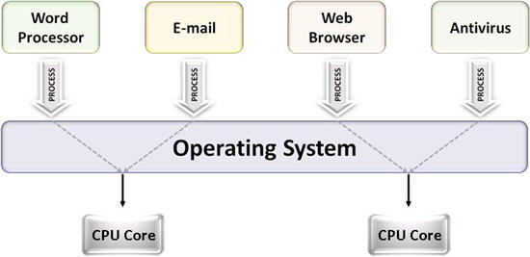
Multi-process Systems…
HIT-BTech-CSEN3103-Operating Systems

Slide 30
Context Save, Scheduling, and Dispatching
Context save function:
  Saves CPU state in PCB, and saves information concerning context
  Changes process state from running to ready
Scheduling function:
  Uses process state information from PCBs to select a ready process for execution and passes its id to dispatching function
Dispatching function:
  Sets up context of process, changes its state to running, and loads saved CPU state from PCB into CPU
  Flushes address translation buffers used by MMU
HIT-BTech-CSEN3103-Operating Systems

Slide 31
A state transition for a process is a change in its state
  Caused by the occurrence of some event such as the start or end of an I/O operation
HIT-BTech-CSEN3103-Operating Systems

Slide 32
Context Switch
The process of changing Context (state) from an executing program (process ➔ Pi) to an interrupt handler is called the Context Switch and its control requires a combination of hardware and software. [What is interrupt?]
When CPU switches to another process, the system must save the state of the old process and load the saved state for the new process.
Context-switch time is overhead; the system does no useful work while switching. Time dependent on hardware support.
A context switch is the mechanism to store and restore the state or context of a CPU in Process Control block so that a process execution can be resumed from the same point at a later time.
Using this technique a context switcher enables multiple processes to share a single CPU. Context switching is an essential part of a multitasking operating system features.
HIT-BTech-CSEN3103-Operating Systems

Slide 33
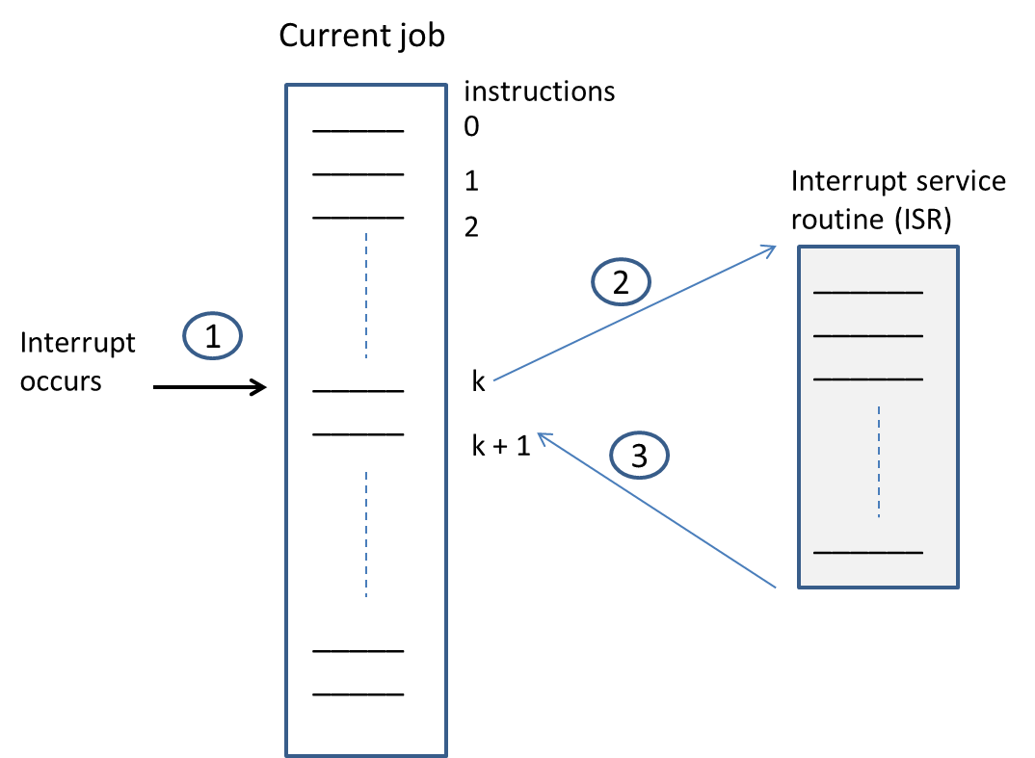
Example of Interrupt-driven I/O
When an I/O command is encountered by the CPU, it hands over the command to the I/O handler.
The I/O handler initiates the I/O operation on the target device.
When the I/O handler is finished with the I/O operation on the device, the I/O handler informs the CPU by issuing an ‘interrupt’.
HIT-BTech-CSEN3103-Operating Systems

Slide 34
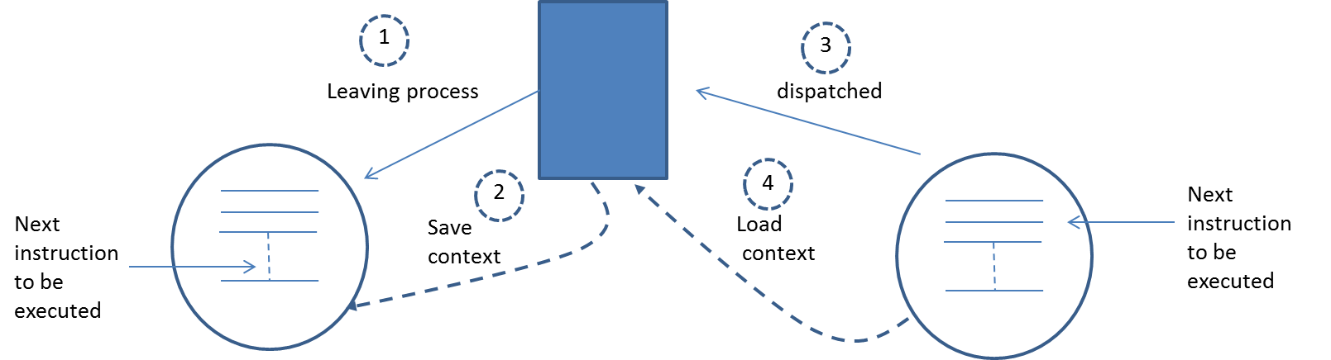
Context Switch
HIT-BTech-CSEN3103-Operating Systems

Slide 35

CPU Context Switch From Process to Process
HIT-BTech-CSEN3103-Operating Systems

Slide 36
Event Handling
Events that occur during the operation in OS:
  Process creation event
  Process termination event
  Timer event
  Resource request event
  Resource release event
  I/O initiation request event
HIT-BTech-CSEN3103-Operating Systems

Slide 37
Event Handling (continued)
Events that occur during the operation in OS (continued):
  I/O completion event
  Message send event
  Message receive event
  Signal send event
  Signal receive event
  A program interrupt
  A hardware malfunction event
HIT-BTech-CSEN3103-Operating Systems

Slide 38
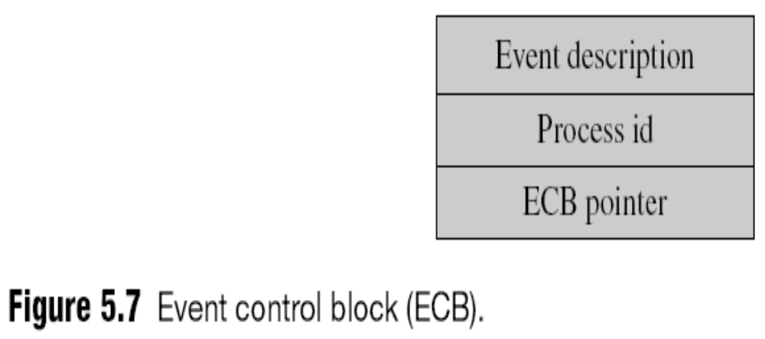
Event Handling (continued)
When an event occurs, the kernel must find the process whose state is affected by it
  OSs use various schemes to speed this up
    E.g., event control blocks (ECBs)
HIT-BTech-CSEN3103-Operating Systems

Slide 39
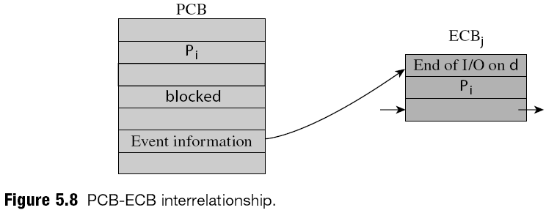
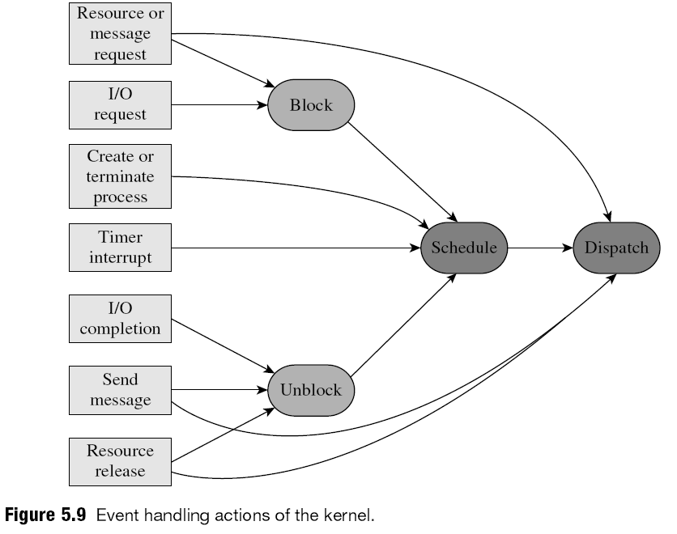
P1 initiates I/O operation on device(d)
HIT-BTech-CSEN3103-Operating Systems

Slide 40
Process Scheduling (continued…)
As processes enter the system, they are put into a job queue.
This queue consists of all processes in the system.
The processes that are residing in main memory and are ready and waiting to execute are kept in the ready queue.
This queue is stored as a linked list.
A ready-queue header contains pointers to the first and final PCBs in the list.
Each PCB is extended to include a pointer that points to the next PCB in the ready queue.
HIT-BTech-CSEN3103-Operating Systems

Slide 41
Process Scheduling Queues
Scheduling queues refers to queues of processes or devices. When the process enters into the system, then this process is put into a job queue.
This queue consists of all processes in the system. The operating system also maintains other queues such as device queue.
Device queue is a queue for which multiple processes are waiting for a particular I/O device. Each device has its own device queue.
The following queuing diagram of process scheduling shows 1) Queue is represented by rectangular box; 2) The circles represent the resources that serve the queues; 3) The arrows indicate the process flow in the system;
HIT-BTech-CSEN3103-Operating Systems

Slide 42
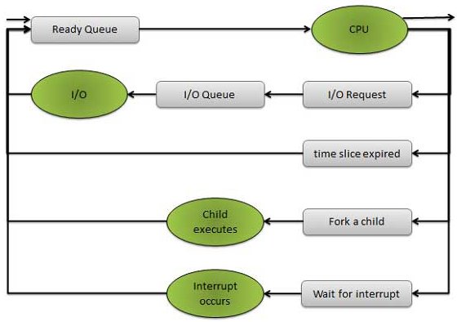
Representation of Process Scheduling
HIT-BTech-CSEN3103-Operating Systems

Slide 43

Ready Queue And Various I/O Device Queues
Linked List
HIT-BTech-CSEN3103-Operating Systems

Slide 44
Process Creation
Parent process creates children processes, which, in turn create other processes, forming a tree of processes.
Resource sharing
  Parent and children share all resources.
  Children share subset of parent’s resources.
  Parent and child share no resources.
Execution
  Parent and children execute concurrently.
  Parent waits until children terminate.
HIT-BTech-CSEN3103-Operating Systems

Slide 45
Process Creation (Cont.)
Address space
  Child duplicate of parent.
  Child has a program loaded into it.
UNIX examples
  fork system call creates new process
  execve system call used after a fork to replace the process’ memory space with a new program.
HIT-BTech-CSEN3103-Operating Systems

Slide 46
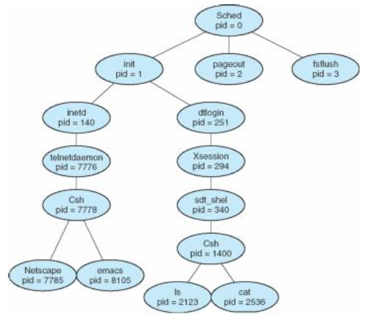
Operating System Concepts – A tree of processes on a typical Solaris
HIT-BTech-CSEN3103-Operating Systems

Slide 47
What process has Process ID 0?
There are two tasks with specially distinguished process IDs: swapper or sched has process ID 0 and is responsible for paging.
This process is actually part of the kernel rather than a normal user-mode process. Process ID 1 is usually the init process primarily responsible for starting and shutting down the system.
Originally, process ID 1 was not specifically reserved for init by any technical measures: it simply had this ID as a natural consequence of being the first process invoked by the kernel.
More recent Unix systems typically have additional kernel components visible as 'processes', in which case PID 1 is actively reserved for the init process to maintain consistency with older systems.
HIT-BTech-CSEN3103-Operating Systems

Slide 48
Process Termination
Process executes last statement and asks the operating system to decide it (exit).
  Output data from child to parent (via wait).
  Process’ resources are deallocated by operating system.
Parent may terminate execution of children processes (abort).
  Child has exceeded allocated resources.
  Task assigned to child is no longer required.
  Parent is exiting.
    Operating system does not allow child to continue if its parent terminates.
    Cascading termination.
HIT-BTech-CSEN3103-Operating Systems

Slide 49
Levels of Scheduling
Ready Queue – These resident processes are waiting for the CPU.
New Jobs – These are waiting to get main memory.
Blocked – These resident processes are waiting for I/O completion.
Ready Suspend – The processes are ready to run but have been swapped out to the hard disk.
Block Suspend – These processes need I/O completion and have been swapped out to the hard disk.
HIT-BTech-CSEN3103-Operating Systems

Slide 50
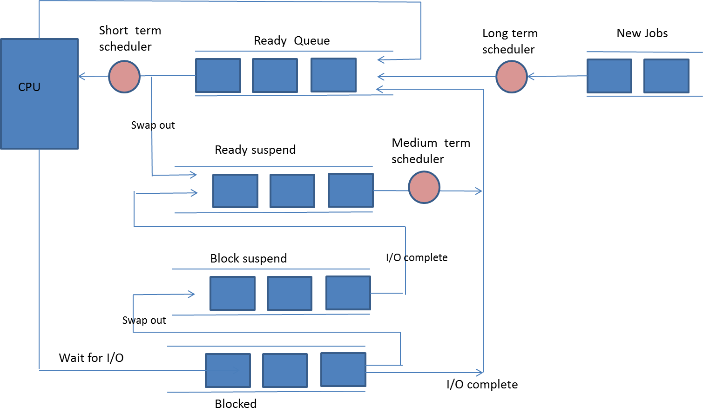
Levels of Scheduling
HIT-BTech-CSEN3103-Operating Systems

Slide 51
HIT-BTech-CSEN3103-Operating Systems

Slide 52
Schedulers
Short-term scheduler manages the fair allocation of CPU time to processes. It makes the schedule of ‘ready to run’ processes. [NEXT SLIDE….]
It is also responsible for efficient process switching. The process switch time should be very small so that the system is able to provide better response time.
The size of the context is also kept to the minimum so that the copying of the context into the PCB consumes the least time.
HIT-BTech-CSEN3103-Operating Systems

Slide 53
Short Term Scheduler
It is also called CPU scheduler.
Main objective is increasing system performance in accordance with the chosen set of criteria.
It is the change of ready state to running state of the process.
CPU scheduler selects processes among a set of processes that are ready to execute and allocates CPU to one of them.
Short term scheduler also known as dispatcher, execute most frequently and makes the fine grained decision of which process to execute next.
Short term scheduler is faster than long term scheduler.
HIT-BTech-CSEN3103-Operating Systems

Slide 54
Schedulers (Cont.)
Short-term scheduler is invoked very frequently (milliseconds)
⇒ (must be fast).
Long-term scheduler is invoked very infrequently (seconds, minutes) ⇒ (may be slow).
The long-term scheduler controls the degree of multiprogramming.
Processes can be described as either:
  I/O-bound process – spends more time doing I/O than computations, many short CPU bursts.
  CPU-bound process – spends more time doing computations; few very long CPU bursts.
HIT-BTech-CSEN3103-Operating Systems

Slide 55
Levels of Scheduling
HIT-BTech-CSEN3103-Operating Systems

Slide 56
Long Term Schedulers (Cont.)
It is also called job scheduler. Long term scheduler determines which programs are admitted to the system for processing.
Job scheduler selects processes from the queue and loads them into memory for execution.
Process loads into the memory for CPU scheduling.
The primary objective of the job scheduler is to provide a balanced mix of jobs, such as I/O bound and processor bound.
It also controls the degree of multiprogramming. If the degree of multiprogramming is stable, then the average rate of process creation must be equal to the average departure rate of processes leaving the system.
Time-sharing operating systems have no long term scheduler. When process changes the state from new to ready, then there is use of long term scheduler.
HIT-BTech-CSEN3103-Operating Systems

Slide 57
Levels of Scheduling
HIT-BTech-CSEN3103-Operating Systems

Slide 58
Medium Term Scheduling
Medium term scheduling is part of the swapping.
It removes the processes from the memory. It reduces the degree of multiprogramming.
The medium term scheduler is in-charge of handling the swapped out-processes.
Running process may become suspended if it makes an I/O request.
Suspended processes cannot make any progress towards completion.
In this condition, to remove the process from memory and make space for other process, the suspended process is moved to the secondary storage.
This process is called swapping, and the process is said to be swapped out or rolled out. Swapping may be necessary to improve the process mix.
HIT-BTech-CSEN3103-Operating Systems

Slide 59
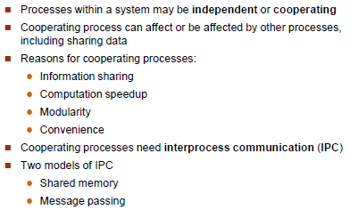
Interprocess Communication (IPC) [more in threads’ slide]
HIT-BTech-CSEN3103-Operating Systems

Slide 60
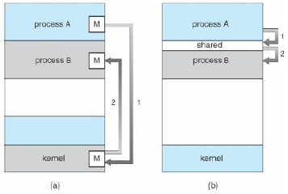
Communications Models
HIT-BTech-CSEN3103-Operating Systems

Slide 61
Cooperating Processes
Independent process cannot affect or be affected by the execution of another process.
Cooperating process can affect or be affected by the execution of another process
Advantages of process cooperation
  Information sharing
  Computation speed-up
  Modularity
  Convenience
HIT-BTech-CSEN3103-Operating Systems

Slide 62
Let’s Understand Cooperating processes using producer-consumer problem
In Producer – Consumer problem a producer process produces information that is consumed by a consumer process. For example, a print program produces characters that are consumed by the printer driver.
A compiler may produce assembly code, which is consumed by an assembler. The assembler, in turn, may produce object modules, which are consumed by the loader.
To allow producer and consumer processes to run concurrently, we must have available a buffer of items that can be filled by the producer and emptied by the consumer.
A producer can produce one item while the consumer is consuming another item. The producer and consumer must be synchronized, so that the consumer does not try to consume an item that has not yet been produced. In this situation, the consumer must wait until an item is produced.
HIT-BTech-CSEN3103-Operating Systems

Slide 63
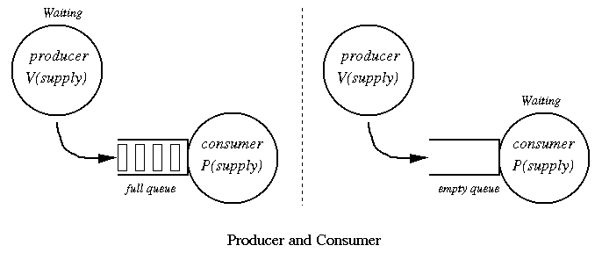
producer-consumer problem
HIT-BTech-CSEN3103-Operating Systems

Slide 64
HIT-BTech-CSEN3103-Operating Systems

